Slide 1



Distributional Methods for detecting Gravitational Waves from core-collapse supernova
Kya Schluterman
Alani Miyoko
Michele Zanolin
Department of Physics and Astronomy, Embry-Riddle Prescott, AZ

Slide 2

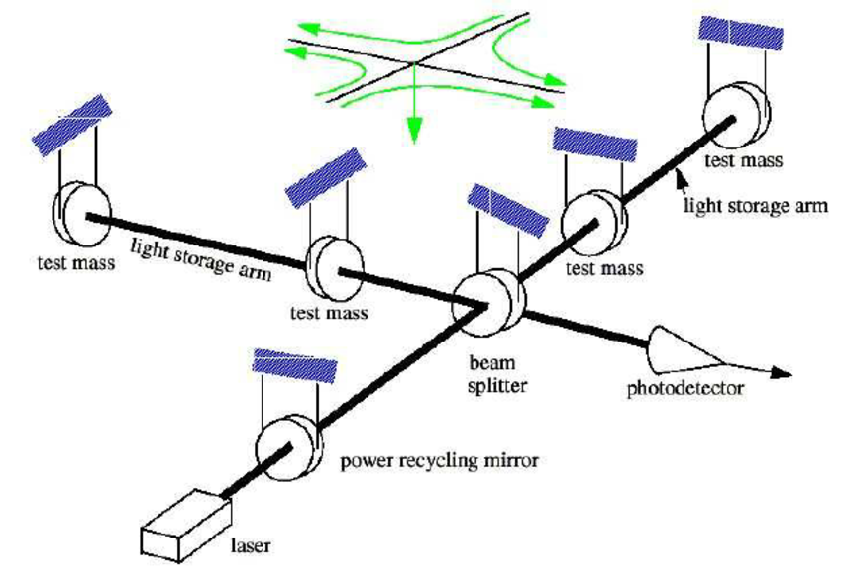
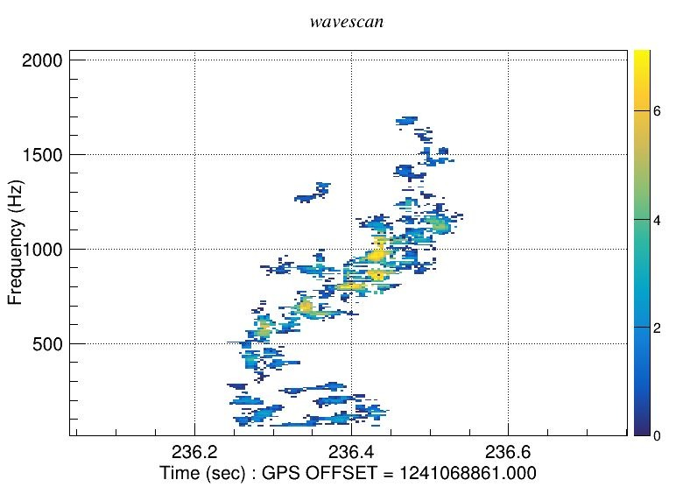
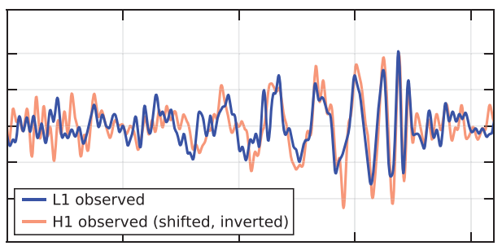
- Gravitational wave
- Ground-based detectors
Rho
- measure of the energy of each event
- Reconstructed strain of space
- Reconstructed time-frequency structure of the GW

Slide 3
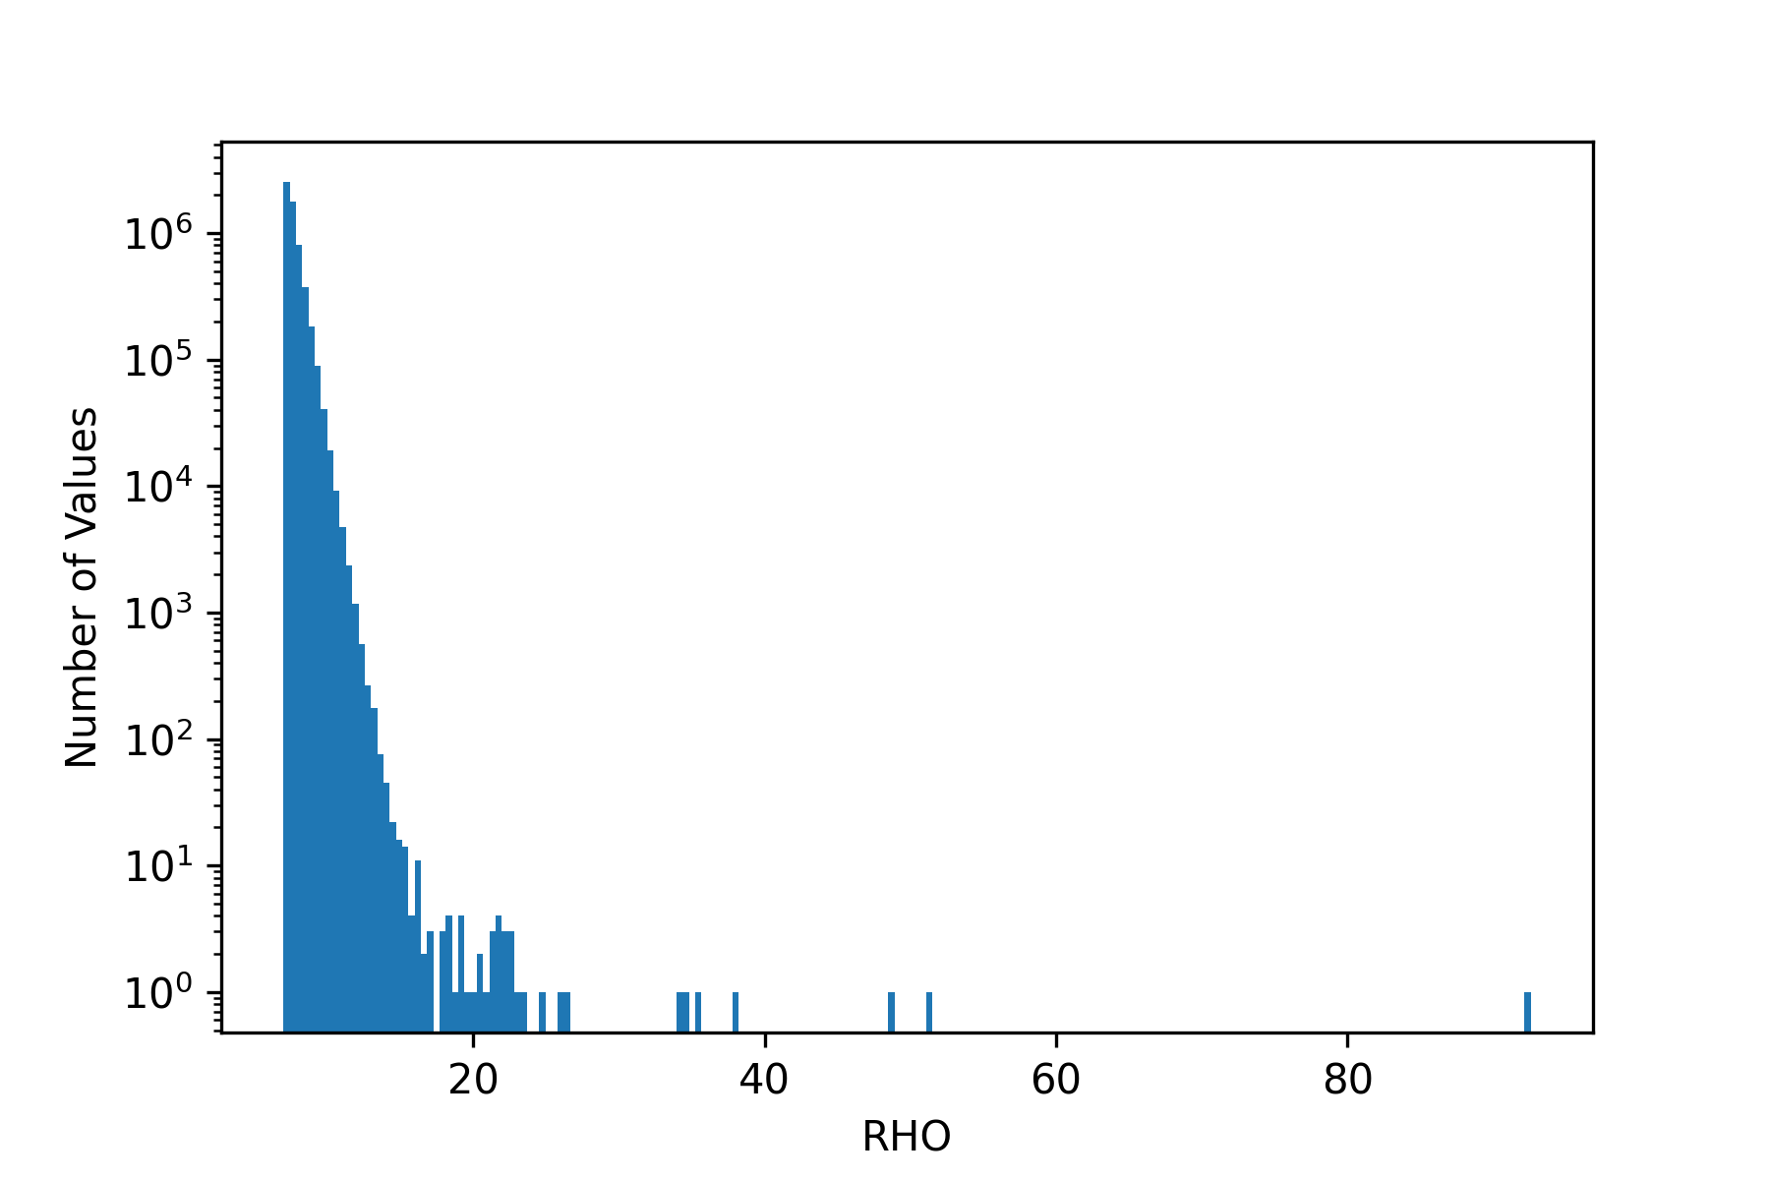
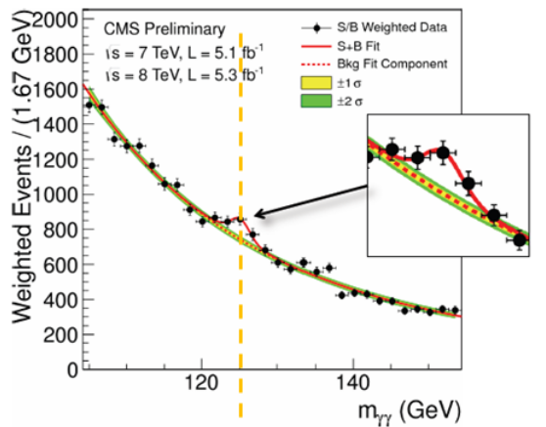
How do we decide if an event is a gravitational wave or a noise transient?
In use now with LIGO:
What we want to implement:
We compare the loudest event with the noise background and declare a detection only if the energy of the event is sufficiently rare
We compare the shape of the distribution of events with respect to the expected shape for a noise-only distribution.

Slide 4
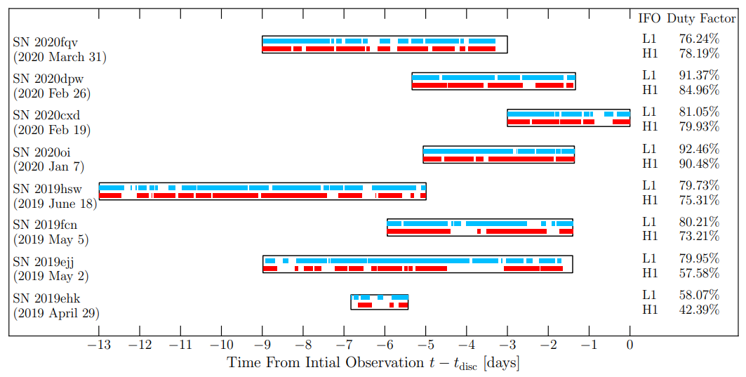
Forming the distribution:
For each SN candidate, we determine a suitable on-source-window of time, based on electromagnetic information, where we think the gravitational wave could occur. We then compare with the available detector data (red and blue above).
We give this data from our two detectors to cWB where it will perform its analysis to produce a large sample of events across the OSW.
We may then merge these candidates’ sets of triggers to form our combined foreground distribution we can compare with a background distribution

Slide 5
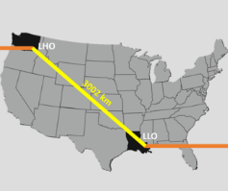
Distributional methodology
Distributional methods are structured around a foreground that (may) contain gravitational waves and background which contains only noise events.
The background distribution comes from shifting the Hanford and Livingston detector data relative to each other and then performing the coherent analysis to determine the triggers. In this way, all coincident events cannot be of astrophysical significance and must be noise.
We produced simulated events corresponding to different source populations and GW emission models
L1-H1 distance = 3002km
~ 0.01s at speed of light

Slide 6
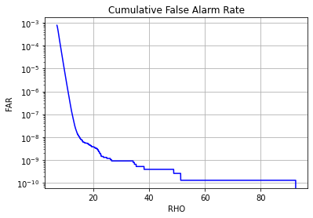
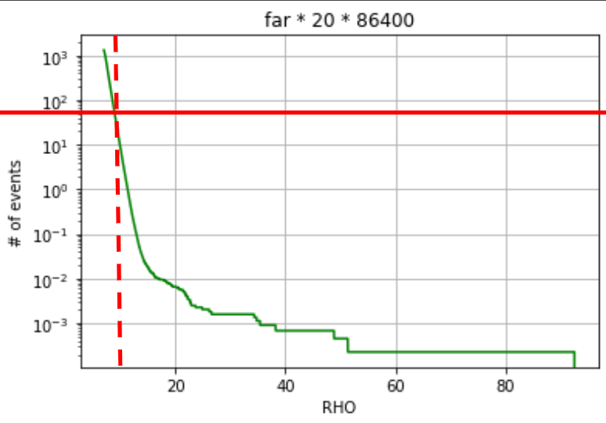
Distributional methodology (Cont.)
For both the foreground and background, we impose a lower-limit on the allowed triggers based on the false-alarm rate of the background and the cumulative on-source-window length of the candidates in the sample.
We then pass these distributions to our set of tests with a false-alarm probability of 5%. This is a tunable parameter to determine the efficiency of the tests.
The tests return a p-value which we use to reject or not reject the null hypothesis
When the SNR thresholds become large, only the loudest events survive. When the thresholds become too low, some of the tests become ineffective.
For example, the FC counting methods can never detect a population with a 5% FAP if the number of CCSNe candidates is less than 2 times the poissonian variance (sqrt(N)) of the surviving noise population.

Slide 7
Nonparametric tests
Feldman-Cousins Counting Method
  'Lower limit' for the capability of any two-sample distributional test
  Allows the user to make statistical inferences on limited datasets, particularly when the shape of the background is unknown.
Kolmogorov-Smirnov
  We employ the two sample Kolmogorov-Smirnov test, which compares two empirical, ranked, distributions to determine if they originate from the same mother distribution.
Anderson-Darling
  We use the k-sample AD test, where we also explore the effect of right-aligned binning versus the midrank method.
Mann-Whitney
  Another non-parametric ranking test, often viewed as comparing the median values of the population through a ranking procedure.
Chi-Squared
  This test generates a set of expected frequencies between categorical variables to measure their degree of association.

Slide 8
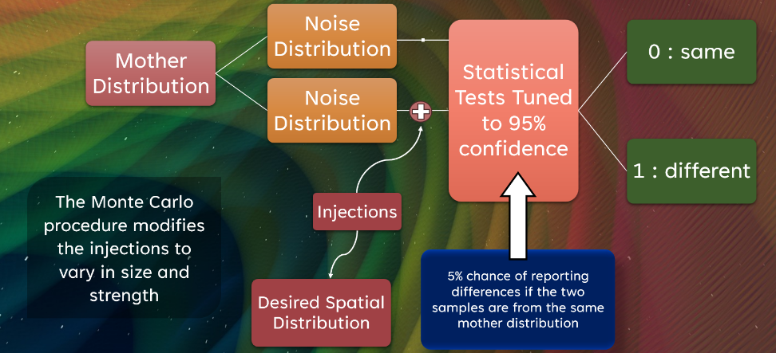
Testing methods
Point injections
  Number of injections
  Injection magnitude
  Small population investigation
Modeled volumes
  Extreme emission models
  Rapid rotation
  Stellar rotation
For each run, we must investigate across the following parameters:
Number of candidates
OSW length
False-alarm rate
Injection frequency
Injection amplitude
Sub-sample size

Slide 9
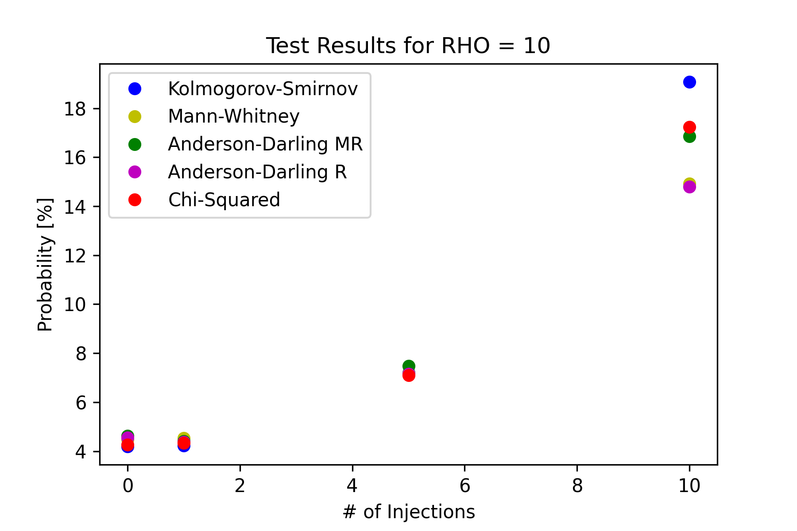
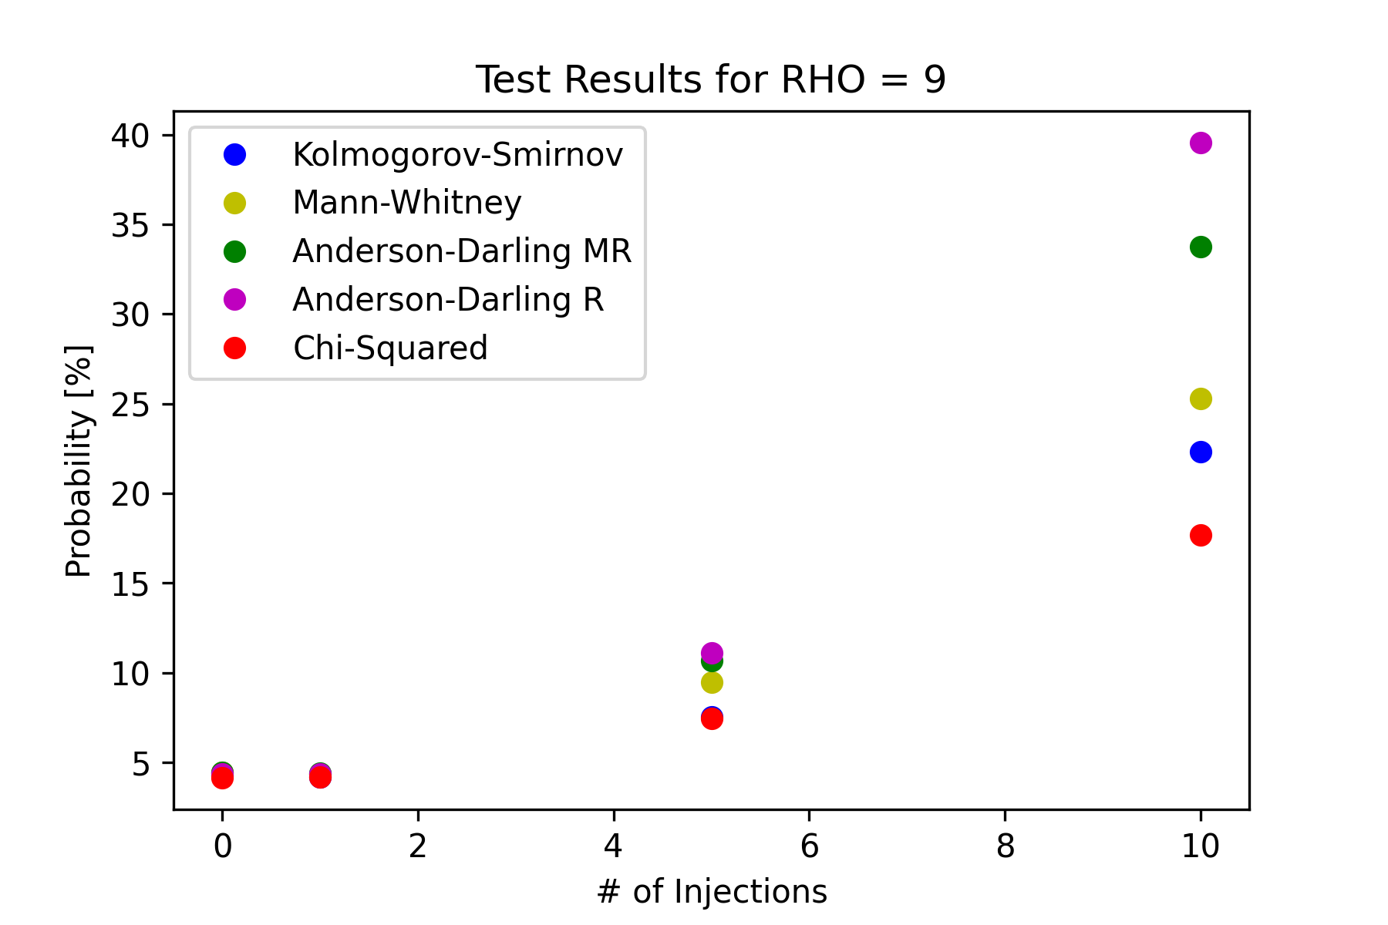
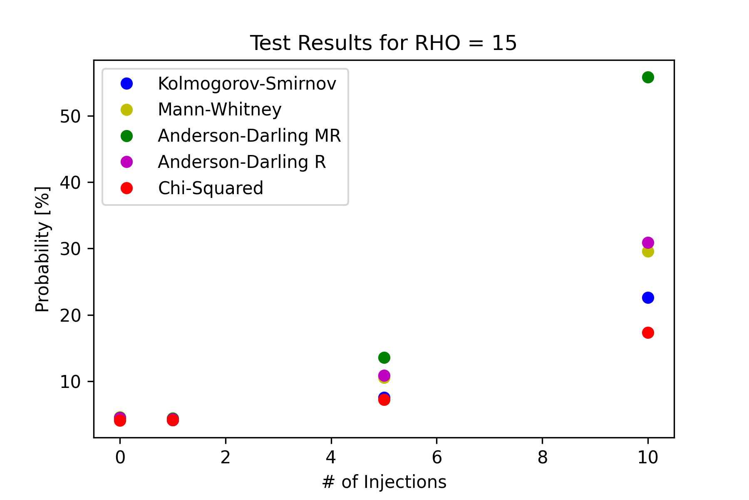
Point-injection efficiencies:
Most recent point-injection test results across range of sample sizes and injection magnitudes.

Slide 10
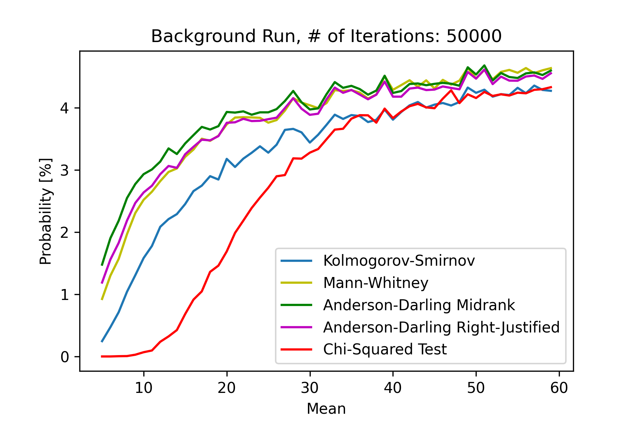
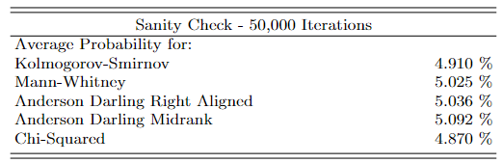
False Alarm Probability inconsistency
Each test needs to be tuned to a true desired FAP otherwise overperforms for small sample sizes – necessary for small population performance
Points to an adaptible false-alarm probability
Ability to tune tests in order to maximize detection efficiency to desired input rate.

Slide 11
Next steps
Quantify typical rho values for GW point injections for various emission models
Investigate small population point performance with respect to adapting test false-alarm probability
Exploration of physically-based injection distributions based on realistic emission models corresponding to an array of progenitor properties.
Further assess the efficiency of these tests compared to one another and to the previous counting and loudest event approaches

Slide 12
Questions?

